Slide 1
CSE3001 - Artificial Intelligence and Machine Learning
SCHOOL OF CSE & IS,
PRESIDENCY UNIVERSITY,
BANGALORE

Slide 2
MODULE 1
Introduction to Artificial Intelligence and Knowledge based systems

Slide 3
CONTENTS
Artificial Intelligence
Introduction
Definitions
Foundation
History
Applications
Agents
Types of Agents, Structure and functions
Agents and Environment
Knowledge Representation
Introduction, Approaches and Issues
Searching Algorithm in AI
Conceptual graphs:
Methods of Logic representation(POL, FOL)

Slide 4
ARTIFICIAL INTELLIGENCE - INTRODUCTION
Homo Sapiens : The name is Latin for "wise man“
Philosophy of AI - “Can a machine think and behave like humans do?”
In Simple Words - Artificial Intelligence is a way of making a computer, a computer-controlled robot, or a software think intelligently, in the similar manner the intelligent humans think.
Artificial intelligence (AI) is an area of computer science that emphasizes the creation of intelligent machines that work and react like humans.
AI is accomplished by studying how human brain thinks, and how humans learn, decide, and work while trying to solve a problem, and then using the outcomes of this study as a basis of developing intelligent software and systems.

Slide 5
What is AI?
Views of AI fall into four categories:
Thinking humanly
Thinking rationally
Acting humanly
Acting rationally
The textbook advocates "acting rationally"

Slide 6
What is AI?
Thinking Humanly “The exciting new effort to make computers think … machines with minds, in the full and literal sense.” “Activities that we associate with human thinking, activities such as decision-making, problem solving, learning…” | Thinking Rationally “The study of mental abilities through the use of computational models.” “The study of the computations that make it possible to perceive, reason and act.”
Acting Humanly “The art of creating machines that perform functions that require intelligence when performed by people.” “The study of how to make computers do things at which, at the moment, people are better.” | Acting Rationally “Computational Intelligence is the study of the design of intelligent agents.” “AI … is concerned with intelligent behavior in artifacts.”

Slide 7
Thinking humanly: Cognitive Modeling
If we are going to say that given program thinks like a human, we must have some way of determining how humans think.
We need to get inside the actual working of human minds.
There are 3 ways to do it:
Through introspection
Trying to catch our own thoughts as they go
Through psychological experiments
Observing a person in action
3. Through brain imaging
Observing the brain in action

Slide 8
Thinking humanly: Cognitive Modeling
Once we have a sufficiently precise theory of the mind, it becomes possible to express the theory as a computer program.
If the program’s input-output behavior matches corresponding human behavior, that is evidence that the program’s mechanisms could also be working in humans.

Slide 9
Thinking Rationally: “Laws of Thought"
Aristotle: one of the first to attempt to codify “right thinking”. Mathematical representation.
His syllogisms provided patterns for argument structures that always yielded correct conclusions when given premises are correct.
Example – Socrates is a man
All men are mortal
Therefore
Socrates is mortal

Slide 10
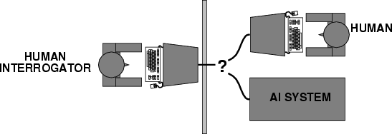
Acting humanly: Turing Test
Turing (1950) developed "Computing machinery and intelligence":
"Can machines think?" → "Can machines behave intelligently?"
Operational test for intelligent behavior: the Imitation Game
A computer passes the test if a human interrogator, after posing some written questions, cannot tell whether the written responses come from a person or from a machine.
Suggested major components of AI: knowledge, reasoning, language understanding, learning

Slide 11
Acting humanly: Turing Test
The computer would need to posses the following capabilities:
Natural Language Processing:
To enable it to communicate successfully in English.
Knowledge representation:
To store what it knows or hear.
Automated reasoning:
To use the stored information to answer questions and to draw new conclusions.
Computer vision: To perceive objects.
Robotics: To manipulate objects and move about.

Slide 12
Acting Rationally: Rational Agent
An agent is an entity that perceives and acts
A system is rational if it does the “right thing,” given what it knows.
This course is about designing rational agents
Rational agent is one that acts so as to achieve the best outcome or, when there is uncertainty, the best expected outcome.
Abstractly, an agent is a function from percept histories to actions:
[f: P* → A]

Slide 13
Definition of AI
Existing definitions advocate everything from replicating human intelligence to simply solving knowledge-intensive tasks.
Examples:
“Artificial Intelligence is the design, study and construction of computer programs that behave intelligently.” -- Tom Dean.
“Artificial Intelligence is the enterprise of constructing a physical symbol system that can reliably pass the Turing test.” -- Matt Ginsberg.

Slide 14
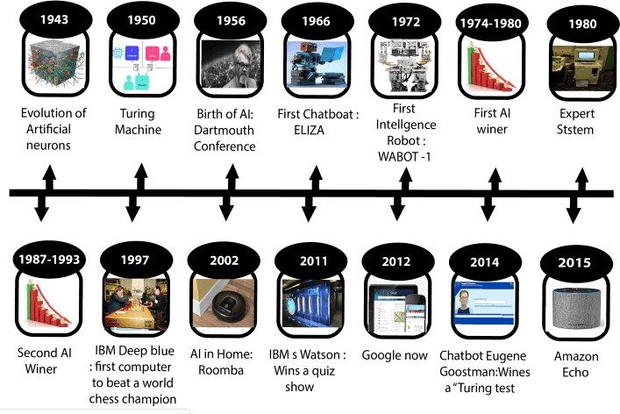
History of AI
Ref : https://www.javatpoint.com/history-of-artificial-intelligence

Slide 15
Applications of AI
Deep Blue(chess-playing computer) defeated the world chess champion Garry Kasparov in 1997
During the 1991 Gulf War, US forces deployed an AI logistics planning and scheduling program that involved up to 50,000 vehicles, cargo, and people
Planning – How to use resources?
Scheduling – When to use the resources?
NASA's on-board autonomous planning program controlled the scheduling of operations for a spacecraft
Google duplex
The GPS developed in 1957 by Alan Newell and Hervert Simon, embodied a grandiose vision

Slide 16
Future Perspective
Reducing the time and cost of development is a big plan for AI.
To develop applications towards strong AI.
(3) Allowing students to work collaboratively is another plan from Researchers.
Perfect rationality: the classical notion of rationality in decision theory.
Bounded optimality: A bounded optimal agent behaves as well as possible given its computational resources.
Game theory studies decision problems in which the utility of a given action depends not only on changing events in the environment but also on the actions of other agents.

Slide 17
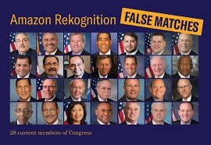


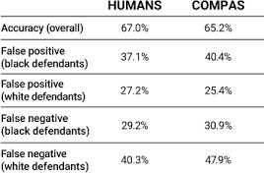
Major Concerns
TAY
COMPAS - Correctional Offender Management Profiling for Alternative Sanctions
Notes:
Tay was an AI chatter bot originally released by Microsoft via Twitter on March 23, 2016. It caused subsequent controversy when the bot began to post inflammatory and offensive tweets through its twitter account, forcing MS to shut down the service only 16 hrs after its launch
COMPAS is a case management and decision support tool developed and owned by Northpointe, used by U.S. courts to assess the likelihood of a defendant becoming a recidivist (recurring offender)

Slide 18
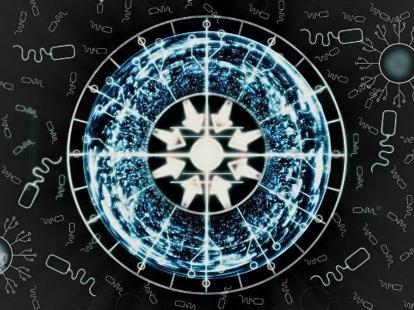

Singularity
Singularity is a hypothetical future point in time at which technological growth becomes uncontrollable and irreversible, resulting in unfathomable changes to human civilization.

Slide 19
AGENTS

Slide 20
Agents in Artificial Intelligence
Artificial intelligence is defined as a study of rational agents. A rational agent could be anything which makes decisions, as a person, firm, machine, or software. It carries out an action with the best outcome after considering past and current percepts(agent’s perceptual inputs at a given instance). An AI system is composed of an agent and its environment. The agents act in their environment.
The environment may contain other agents. An agent is anything that can be viewed as :
perceiving its environment through sensors and
acting upon that environment through actuators

Slide 21
The Structure of Intelligent Agents
Agent’s structure can be viewed as −
Agent = Architecture + Agent Program
Architecture = the machinery that an agent executes on.
Agent Program = an implementation of an agent function.
To understand the structure of Intelligent Agents, we should be familiar with Architecture and Agent Program. Architecture is the machinery that the agent executes on. It is a device with sensors and actuators, for example : a robotic car, a camera, a PC. Agent program is an implementation of an agent function. An agent function is a map from the percept sequence(history of all that an agent has perceived till date) to an action.

Slide 22
Agent Terminology
Performance Measure of Agent − It is the criteria, which determines how successful an agent is.
Behavior of Agent − It is the action that agent performs after any given sequence of percepts.
Percept − It is agent’s perceptual inputs at a given instance.
Percept Sequence − It is the history of all that an agent has perceived till date.
Agent Function − It is a map from the precept sequence to an action.

Slide 23
Rationality
Rationality is nothing but status of being reasonable, sensible, and having good sense of judgment.
Rationality is concerned with expected actions and results depending upon what the agent has perceived. Performing actions with the aim of obtaining useful information is an important part of rationality.
What is Ideal Rational Agent?
An ideal rational agent is the one, which is capable of doing expected actions to maximize its performance measure, on the basis of −
Its percept sequence, built-in knowledge base
Rationality of an agent depends on the following −
The performance measures, which determine the degree of success.
Agent’s Percept Sequence till now. The agent’s prior knowledge about the environment.

Slide 24
Rationality
The actions that the agent can carry out.
A rational agent always performs right action, where the right action means the action that causes the agent to be most successful in the given percept sequence. The problem the agent solves is characterized by Performance Measure, Environment, Actuators, and Sensors (PEAS).

Slide 25
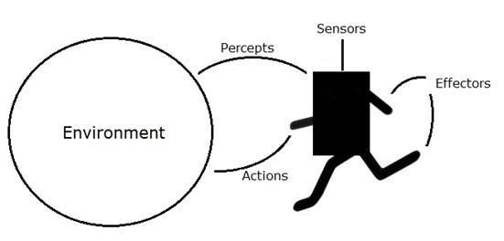
Examples of Agent Environment:-
An agent is anything that can perceive its environment through sensors and acts upon that environment through effectors.
A human agent has sensory organs such as eyes, ears, nose, tongue and skin parallel to the sensors, and other organs such as hands, legs, mouth, for effectors.
A robotic agent replaces cameras and infrared range finders for the sensors, and various motors and actuators for effectors.
A software agent has encoded bit strings as its programs and actions.

Slide 26
Types of Agents
Agents can be grouped into five classes based on their degree of perceived intelligence and capability. All these agents can improve their performance and generate better action over the time. These are given below:
Simple Reflex Agent
Model-based reflex agent
Goal-based agents
Utility-based agent
Learning agent

Slide 27
Simple Reflex Agent
The Simple reflex agents are the simplest agents. These agents take decisions on the basis of the current percepts and ignore the rest of the percept history.
These agents only succeed in the fully observable environment.
The Simple reflex agent does not consider any part of percepts history during their decision and action process.
The Simple reflex agent works on Condition-action rule, which means it maps the current state to action. Such as a Room Cleaner agent, it works only if there is dirt in the room.
Problems for the simple reflex agent design approach:
They have very limited intelligence
They do not have knowledge of non-perceptual parts of the current state
Mostly too big to generate and to store also not adaptive to changes in the environment.

Slide 28
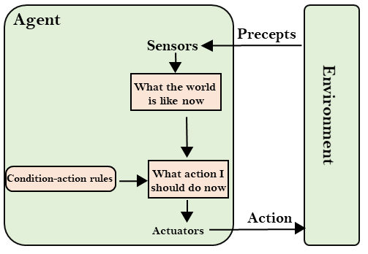
Simple Reflex Agent

Slide 29
Model-based reflex agent
The Model-based agent can work in a partially observable environment, and track the situation.
A model-based agent has two important factors:
Model: It is knowledge about "how things happen in the world," so it is called a Model-based agent.
Internal State: It is a representation of the current state based on percept history.
These agents have the model, "which is knowledge of the world" and based on the model they perform actions.
Updating the agent state requires information about:
How the world evolves
How the agent's action affects the world.

Slide 30
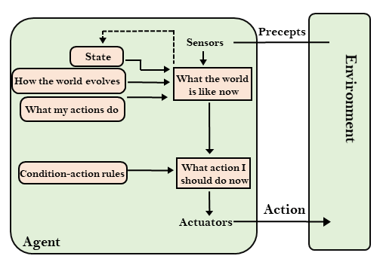
Model-based reflex agent

Slide 31
Goal-based agents
The knowledge of the current state environment is not always sufficient to decide for an agent to what to do.
The agent needs to know its goal which describes desirable situations.
Goal-based agents expand the capabilities of the model-based agent by having the "goal" information.
They choose an action, so that they can achieve the goal.
These agents may have to consider a long sequence of possible actions before deciding whether the goal is achieved or not. Such considerations of different scenario are called searching and planning, which makes an agent proactive.

Slide 32
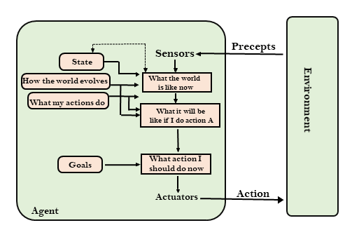
Goal-based agents

Slide 33
Utility-based agents
These agents are similar to the goal-based agent but provide an extra component of utility measurement which makes them different by providing a measure of success at a given state.
Utility-based agent act based not only goals but also the best way to achieve the goal.
The Utility-based agent is useful when there are multiple possible alternatives, and an agent has to choose in order to perform the best action.
The utility function maps each state to a real number to check how efficiently each action achieves the goals.

Slide 34
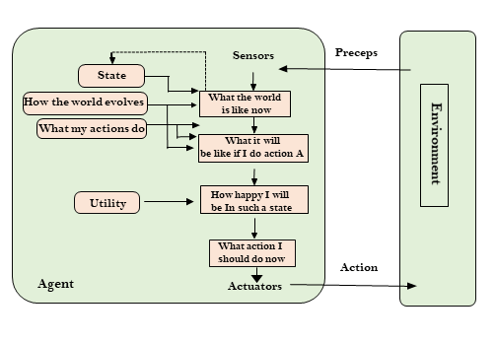
Utility-based agents

Slide 35
Learning Agents
A learning agent in AI is the type of agent that can learn from its past experiences, or it has learning capabilities.
It starts to act with basic knowledge and then is able to act and adapt automatically through learning.
A learning agent has mainly four conceptual components, which are:
Learning element: It is responsible for making improvements by learning from the environment
Critic: The learning element takes feedback from the critic which describes that how well the agent is doing with respect to a fixed performance standard.
Performance element: It is responsible for selecting external action
Problem generator: This component is responsible for suggesting actions that will lead to new and informative experiences.
Hence, learning agents are able to learn, analyze performance, and look for new ways to improve performance.

Slide 36
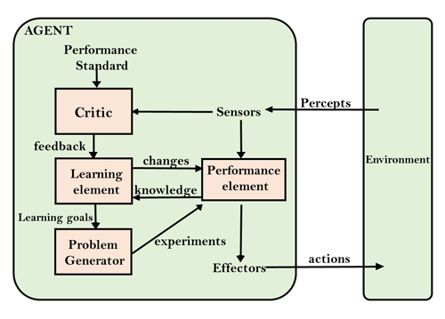
Learning Agents

Slide 37
AGENTS AND ENVIRONMENT
Some programs operate in the entirely artificial environment confined to keyboard input, database, computer file systems and character output on a screen.
In contrast, some software agents (software robots or soft bots) exist in rich, unlimited soft bots domains. The simulator has a very detailed, complex environment.
The most famous artificial environment is the Turing Test environment, in which one real and other artificial agents are tested on equal ground.
The success of an intelligent behavior of a system can be measured with Turing Test.
Two persons and a machine to be evaluated participate in the test. Out of the two persons, one plays the role of the tester. Each of them sits in different rooms. The tester is unaware of who is machine and who is a human.

Slide 38
Properties/Features of Environment
Discrete / Continuous
Observable / Partially Observable
Static / Dynamic
Single agent / Multiple agents
Accessible / Inaccessible
Deterministic / Non-deterministic
Episodic / Non-episodic

Slide 39
KNOWLEDGE REPRESENTATION

Slide 40
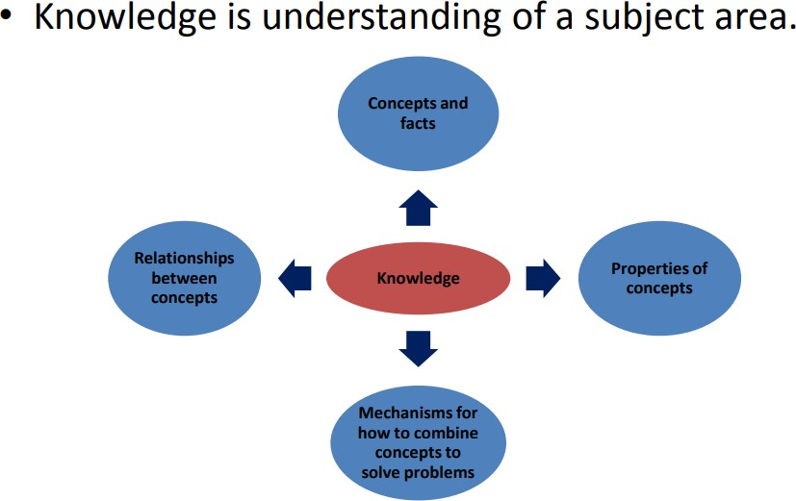
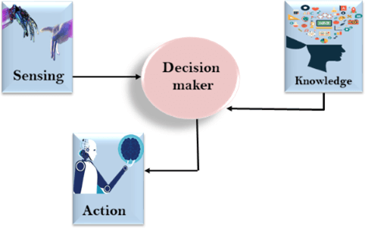
Introduction to knowledge
Knowledge is the sort of information that people use to solve problems.
Knowledge is having familiarity with the language, concepts, procedures, rules, ideas, places, customs, facts, and associations.
Ref : https://nptel.ac.in/courses/126104006/LectureNotes/Week-3_Knowledge%20Representation.pdf https://www.javatpoint.com/knowledge-representation-in-ai

Slide 41
Knowledge
Definition and Importance of Knowledge
Knowledge-Based Systems
Knowledge Organization
Representation of Knowledge
Logic
Associative Networks
Frame Structures
Conceptual graphs

Slide 42
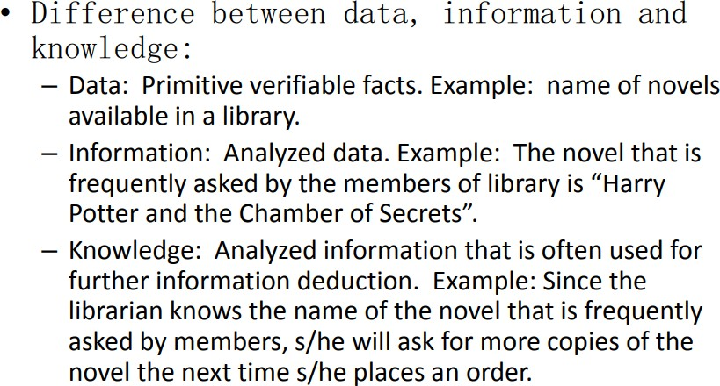
Ref : https://nptel.ac.in/courses/126104006/LectureNotes/Week-3_Knowledge%20Representation.pdf

Slide 43
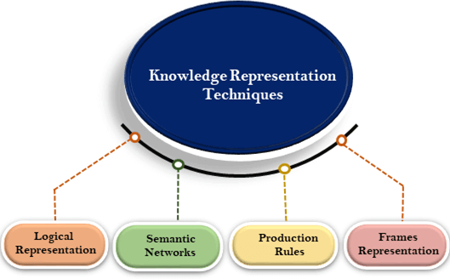
Introduction to Knowledge Representation (KR)
The method used to encode knowledge in an KBS’s Knowledge base
The field of AI dedicated to representing information about the world in a
form that a computer system can utilize to solve complex tasks
https://www.javatpoint.com/ai-techniques-of-knowledge-representation

Slide 44
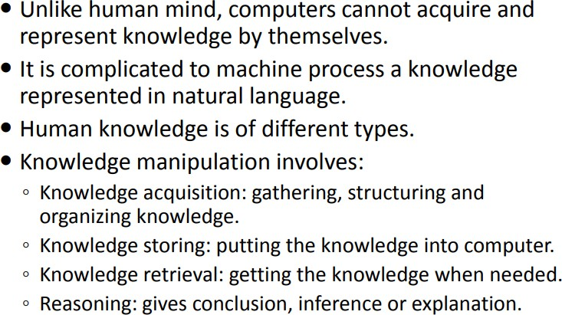
Why do we need Knowledge Representation?
Ref : https://nptel.ac.in/courses/126104006/LectureNotes/Week-3_Knowledge%20Representation.pdf

Slide 45
Knowledge Representation Schemas
Logical schemas - First-order logic - Higher-order logic | Network schemas - Semantic networks - Conceptual graphs
Procedural schemas - Rule-based systems | Structural schemas - Frames - Scripts

Slide 46
Common Techniques/Issues of KR
Object – Attribute – Value Triplets (O-A-V)
Rules
Semantic Networks
Frames
Logic

Slide 47
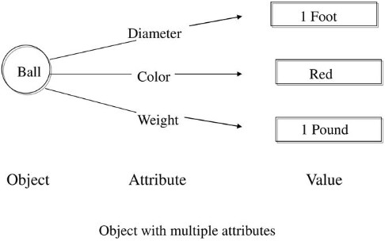
Object – Attribute – Value Triplets (O-A-V)
The Ball is round in shape
Object: Ball
Attribute: Shape
Value: Red

Slide 48
Rules
Rule: A knowledge structure that relates some known information to other information that can be concluded or inferred
A rule describes how to solve a problem
Expert systems employing rules are called rule-based expert systems

Slide 49
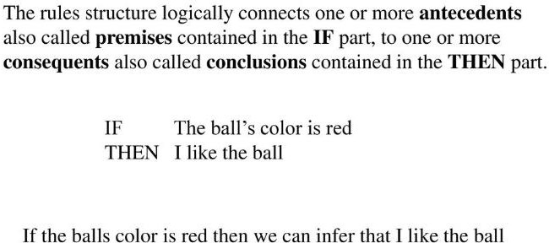
Structure of Rule

Slide 50
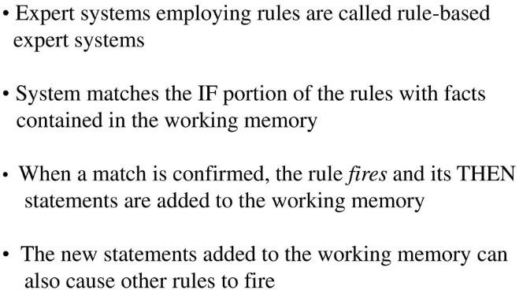
Working Memory

Slide 51
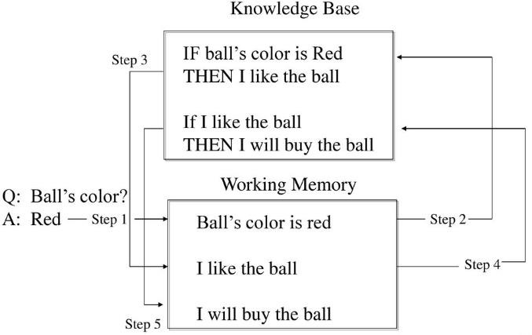
Inference Engine

Slide 52
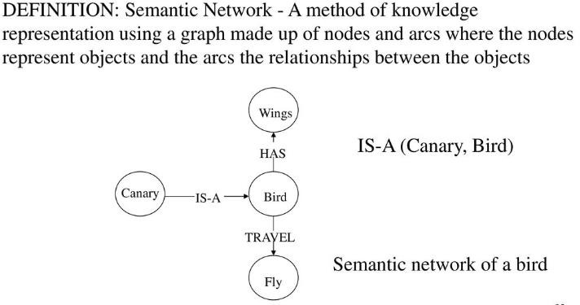
Semantic Networks

Slide 53
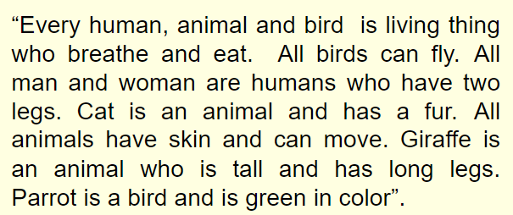
Draw a Semantic Network

Slide 54
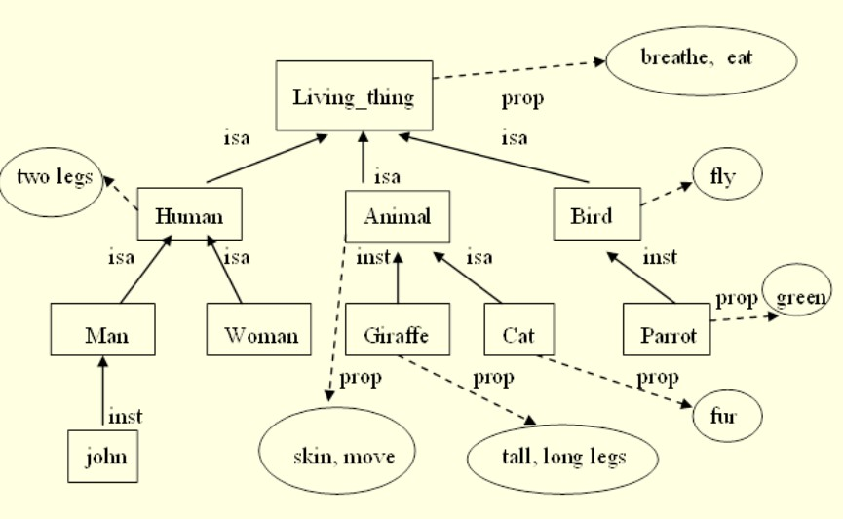
https://www.slideserve.com/kacy/knowledge-representation-techniques

Slide 55
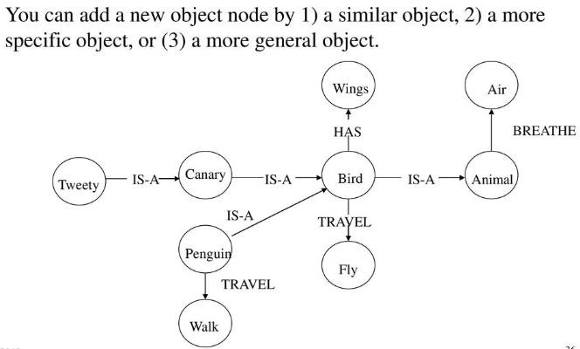
Semantic Networks

Slide 56
Associative Networks
Semantic networks consist of nodes, links (edges) and link labels.
nodes appear as circles or ellipses or rectangles to represent objects such as physical objects, concepts or situations.
Links appear as arrows to express the relationships between objects .
link labels specify particular relations .
As nodes are associated with other nodes semantic nets are also referred to as Associative Networks.
Semantic Networks, Frames and Scripts are sometimes called as Associative Networks.

Slide 57
Associative Networks
Example : mother(john, sue) age(john,5) wife(sue,max) age(max,34)
Sue
mother
age
John
5
34
Max
age

Slide 58
Associative Networks
It's defined as various kinds of links between the concepts.
“has-part” or aggregation.
“is-a” or specialization.
More specialized depending on domain.
It typically also includes Inheritance and some kind of procedural attachment.
Example :
- Tom is a Bird.
- Bird is a Animal.
- Bird has part Wings.

Slide 59

Associative Networks
The ISA (is-a) or AKO (a-kind-of) relation is often used to link instances to classes, classes to super classes
Example; Tom is a Bird. Bird is a Animal.
Bird has part Wings.
Some links (e.g. has Part) are
inherited along ISA paths.
The semantics of a semantic net can be relatively informal or very formal – often defined at the implementation level
Is-a
Bird
Animal
has-part
Tom
wings

Slide 60
Knowledge-based agent and its Structure
Knowledge-based agents are those agents who have the capability of maintaining an internal state of knowledge, reason over that knowledge, update their knowledge after observations and take actions. These agents can represent the world with some formal representation and act intelligently.
Knowledge-based agents are composed of two main parts:
Knowledge-base and
Inference system.
A knowledge-based agent must able to do the following:
An agent should be able to represent states, actions, etc.
An agent Should be able to incorporate new percepts
An agent can update and deduce the internal representation of the world. An agent can deduce appropriate actions.

Slide 61
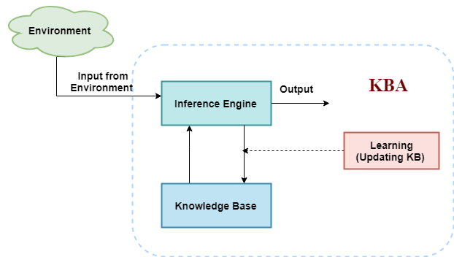
The Structure of knowledge-based agent:
The knowledge-based agent (KBA) take input from the environment by perceiving the environment.
The input is taken by the inference engine of the agent and which also communicate with KB to decide as per the knowledge store in KB.
The learning element of KBA regularly updates the KB by learning new knowledge.

Slide 62
Knowledge base: Knowledge-base is a central component of a knowledge-based agent, it is also known as KB. It is a collection of sentences (here 'sentence' is a technical term and it is not identical to sentence in English). These sentences are expressed in a language which is called a knowledge representation language. The Knowledge-base of KBA stores fact about the world.
Inference system:
Inference means deriving new sentences from old. Inference system allows us to add a new sentence to the knowledge base. A sentence is a proposition about the world. Inference system applies logical rules to the KB to deduce new information.
Inference system generates new facts so that an agent can update the KB. An inference system works mainly in two rules which are given as:
Forward chaining
Backward chaining

Slide 63
Operations Performed by KBA
Following are three operations which are performed by KBA in order to show the intelligent behavior:
TELL: This operation tells the knowledge base what it perceives from the environment.
ASK: This operation asks the knowledge base what action it should perform.
Perform: It performs the selected action.

Slide 64
Knowledge Based Systems (KBS)
A Knowledge-based system(KBS) is a computer program that reasons and uses a knowledge base to solve complex problems.
A system which is built around a knowledge base. i.e. a collection of knowledge, taken from a human, and stored in such a way that the system can reason with it.
Uses AI to solve problems within a specialized domain that ordinarily requires human expertise.
Uses Heuristic (cause and effect) rather than algorithms.
E.g.
Expert Systems
Clinical decision-support systems
MYCIN, for example, was an early knowledge-based system created to help doctors diagnose diseases

Slide 65
KBS Examples
Expert Systems
One in which the knowledge, stored in the knowledge base, has been taken from an expert in some particular field.
Expert systems are designed to solve complex problems by reasoning through bodies of knowledge, represented mainly as if–then rules rather than through conventional procedural code.
Therefore, an expert system can, to a certain extent, act as a substitute for the expert from whom the knowledge was taken.
Clinical decision-support systems
MYCIN, for example, was an early knowledge-based system
created to help doctors diagnose diseases.

Slide 66
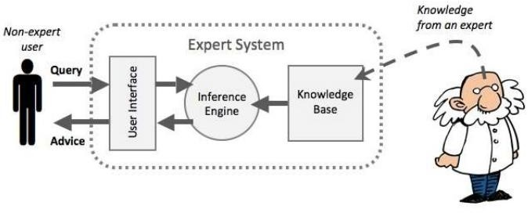
KBS Architecture
https://www.researchgate.net/figure/Expert-System-Architecture-23-Knowledge-Base_fig1_319208444

Slide 67
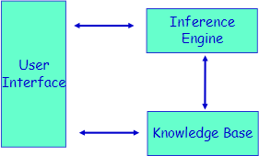
KBS Architecture
User Interface
– Enables the user to communicate with KBS

Slide 68
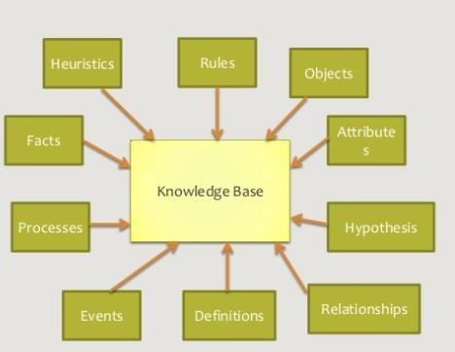
KBS Architecture
KBS = Knowledge-Base + Inference Engine
Knowledge Base

Slide 69
Knowledge base System
Storing knowledge inside the program
#include<stdio.h> int main()
{
char dob=“20/08/1992”;
………….
………….
#Knowledge
}
Instead write the dob in text file and access the date of birth from the text file
Text file: dob.txt
20/08/1992

Slide 70
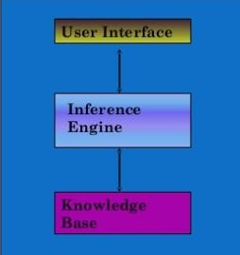
KBS Architecture continued
Inference Engine :
Tries to derive answers from knowledge base.
Brain of KBS that provides a methodology for reasoning about the information in the knowledge base and for formulating conclusions.

Slide 71
Example 1 for AI system: Gender Identification Problem
Male and female names have some distinctive characteristics.
Names ending in a, e and i are likely to be female.
Names ending in k, n, r, s and t are likely to be male.
Input File: male.txt
Amit Prasan Ashok Ankit Amar Chetan Shashank Sumant
Input File: female.txt
Reshma Akshata Vani Sita Bhavani Lalita Ankita Harika
Output: Predict the Gender for the following names:
Karan
Sameera

Slide 72
Architecture of AI Components of Knowledge base System
Input – Output
Unit
Inference- control Unit
Knowledge
base
Input-output: male.txt and female.txt
Knowledge base:
From the last character in the name identification of gender is
possible.
Inference-control Unit: AI Algorithm Implementation – Programs
Example: Naïve Bayes Algorithm, Decision Tree Algorithm

Slide 73
List of Common Algorithms:
Naive Bayes
Decision Trees
Linear Regression
Support Vector Machines (SVM)
Neural Networks

Slide 74
Example 2 for AI system: Movie Rating
Airlift Movie rating – Reviews
(Movie site, Facebook, Blog)
Post - How is Airlift Movie?
Comments from the people who watched movie -
Airlift Movie is nice.
It’s boring.
Yesterday I went to the movie. I enjoyed it.
Superb.

Slide 75
Architecture of AI Components of Knowledge base System
Input – Output
Unit
Inference- control Unit
Knowledge
base
Input-output: Facebook, twitter and movie site comments about the movie.
Knowledge base: Contains the positive, negative and neutral keywords
(Dictionary).
Inference-control Unit: AI Algorithm Implementation – Programs
Example: NLP Algorithms, Naïve Bayes Algorithm, Support Vector Machines

Slide 76
Architecture of AI Components of Knowledge base System
Input – Output
Unit
Inference- control Unit
Knowledge
base
Knowledge-based systems – get the power from expert knowledge that has been coded into facts, heuristics, and procedures.
The knowledge is stored in knowledge base separate from the
control and inference components.
This makes possible to add new knowledge or refine existing knowledge without recompiling the control and inference programs.

Slide 77
SEARCH ALGORITHM IN AI

Slide 78
SEARCH ALGORITHM TERMINOLOGIES
Search: Searching is a step by step procedure to solve a search-problem in a given search space. A search problem can have three main factors: Search Space: Search space represents a set of possible solutions, which a system may have. Start State: It is a state from where agent begins the search. Goal test: It is a function which observe the current state and returns whether the goal state is achieved or not. Search tree: A tree representation of search problem is called Search tree. The root of the search tree is the root node which is corresponding to the initial state. Actions: It gives the description of all the available actions to the agent. Transition model: A description of what each action do, can be represented as a transition model. Path Cost: It is a function which assigns a numeric cost to each path. Solution: It is an action sequence which leads from the start node to the goal node. Optimal Solution: If a solution has the lowest cost among all solutions.

Slide 79
PROPERTIES OF SEARCH ALGORITHM
Completeness: A search algorithm is said to be complete if it guarantees to return a solution if at least any solution exists for any random input.
Optimality: If a solution found for an algorithm is guaranteed to be the best solution (lowest path cost) among all other solutions, then such a solution for is said to be an optimal solution.
Time Complexity: Time complexity is a measure of time for an algorithm to complete its task.
Space Complexity: It is the maximum storage space required at any point during the search, as the complexity of the problem.

Slide 80
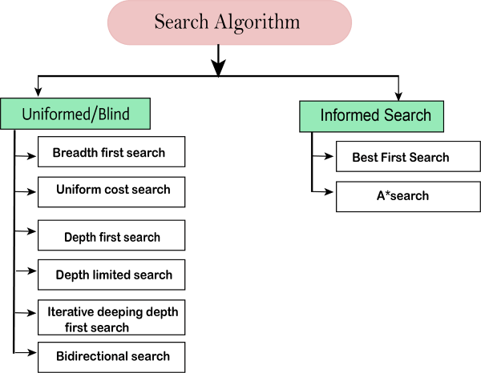
A* SEARCH
https://www.youtube.com/watch?v=tvAh0JZF2YE

Slide 81
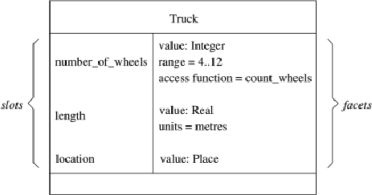
FRAME STRUCTURES
Semantic networks morphed into Frame representation Languages in the ‘70s and ‘80s.
A frame is a lot like the notion of an
object in OOP, but has more meta-data.
Represents related knowledge about a subject
A frame has a set of slots.
A slot represents a relation to another frame (or value). A slot has one or more facets.
A facet represents some aspect of the relation. Facet : A slot in a frame holds more than a value

Slide 82
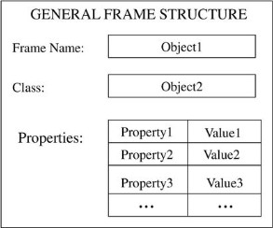
Frame
A data structure for representing stereotypical knowledge of some concept
A frame is a collection of attributes and associated values that describe some entity in the world.
Frames are general record like structures which consist of a collection of slots and slot values.

Slide 83
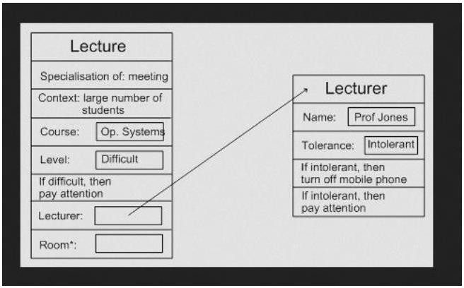
FRAME STRUCTURES
Example :
(Jones)
(Profession (Value Lecturer))
(Age (Value 25 ))
(City (Value Yelahanka))
(State (Value Karnataka))
* Note : value is a Keyword.

Slide 84
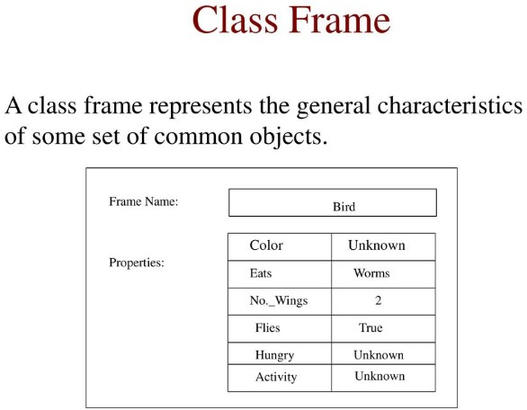

Slide 85
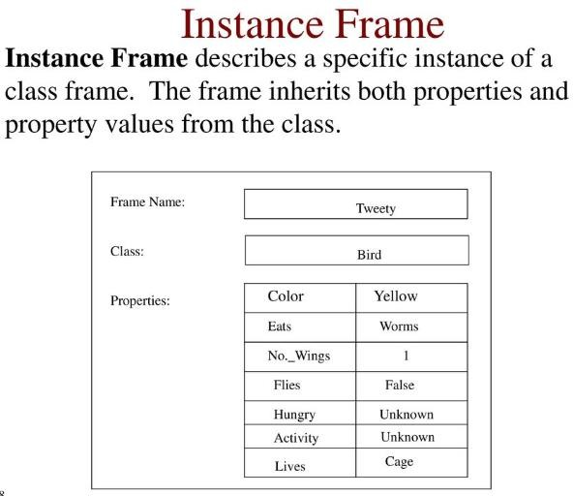

Slide 86
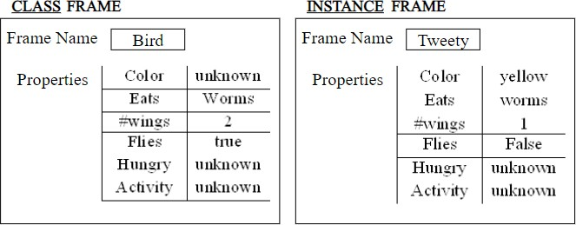

Slide 87
Conceptual Graphs
Conceptual graph
A finite, connected, bipartite graph.
No arc labels, instead the conceptual relation nodes represent relations between concepts
Concepts are represented as boxes and conceptual relations as ellipses
Nodes
Concept Nodes – box nodes
– Concrete concepts:
» These concepts are characterized by our ability to form an image of them in our minds.
» cat, telephone, classroom
» Concrete concepts include generic concepts such as cat or book along with concepts of
specific cats and books

Slide 88
Abstract objects:
» Abstract Concepts that do not correspond to images in our minds
» love, beauty, loyalty
Conceptual Relation Nodes – ellipse nodes
– Relations involving one or more concepts
– Some special relation nodes, namely, agent, recipient, object, experiencer, are used to link a subject and the verb
– Arity – number of box nodes linked to

Slide 89
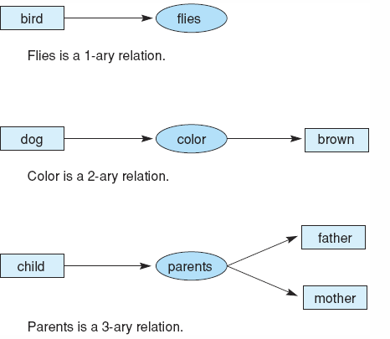
Conceptual Graphs
Example :

Slide 90
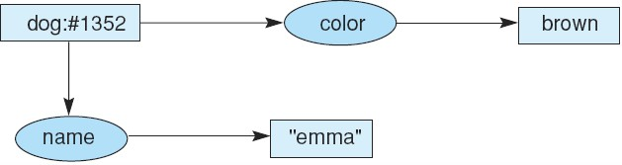
Conceptual Graphs
Example:
Conceptual graph indicating that the dog named Emma is brown.
Conceptual graph indicating that a particular (but unnamed) dog is brown.
Conceptual graph indicating that a dog named Emma is brown.

Slide 91
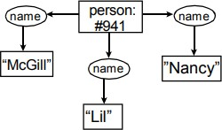
Example: Her name was McGill and she called herself Lil, but everyone knew her as Nancy

Slide 92
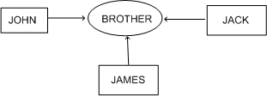
Conceptual Graphs
Example:
Each graph represents a single proposition.
Advantage:
– Single relationship between multiple concepts is easily representable.

Slide 93
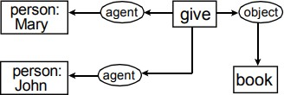
Example: Mary gave John the book

Slide 94
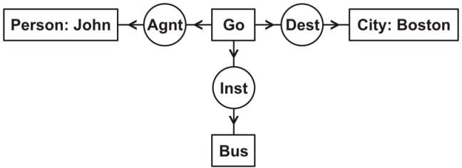
Example: John is going to Boston by bus
Each of the four concepts has a type label, which represents the type of entity the concept refers to: Person, Go, Boston, or Bus.
Two of the concepts have names, which identify the referent: John or Boston.
Each of the three conceptual relations has a type label that represents the type of relation: agent (Agnt), destination (Dest), or instrument (Inst).
The CG as a whole indicates that the person John is the agent of some instance of going, the city Boston is the destination, and a bus is the instrument.

Slide 95
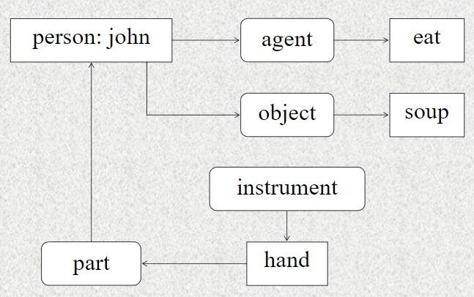
Example: John agent eat object soup instrument hand part

Slide 96
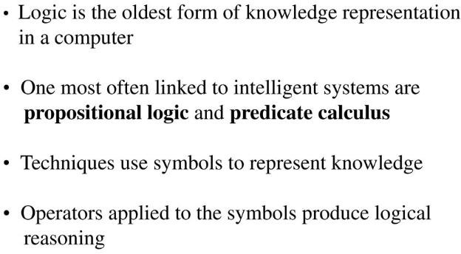
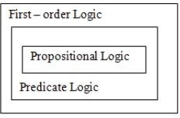
Logic
A logic is a formal language, with precisely defined syntax and semantics, which supports sound inference.
Different logics exist, which allow you to represent different kinds of things, and which allow more or less efficient inference.

Slide 97
THANK YOU

